Slide 1
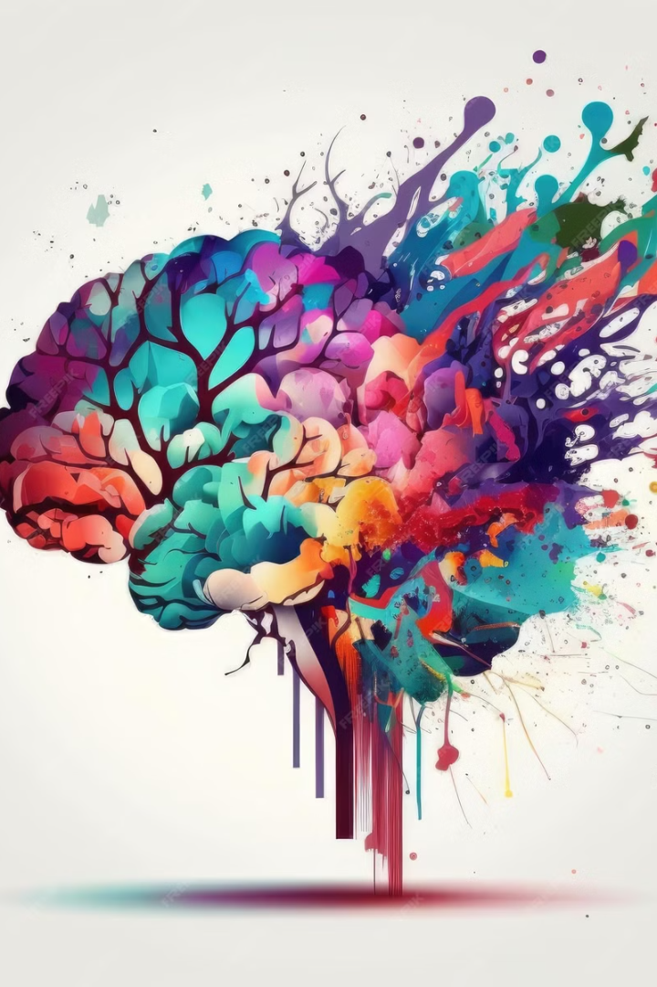
MindGuard+: Revolutionizing Digital Mental Health
In today's digital age, children are increasingly vulnerable to mental health challenges. MindGuard+ offers a revolutionary AI-powered solution to address this critical issue.

Slide 2
The Growing Need for MindGuard+
Mental Health Crisis
Early Detection is Key
MindGuard+'s Solution
Children face a growing mental health crisis with increasing rates of anxiety and depression.
Early detection of mental health issues is crucial for timely intervention and improved outcomes.
MindGuard+ offers a privacy-focused, AI-powered solution for real-time behavioral monitoring.

Slide 3
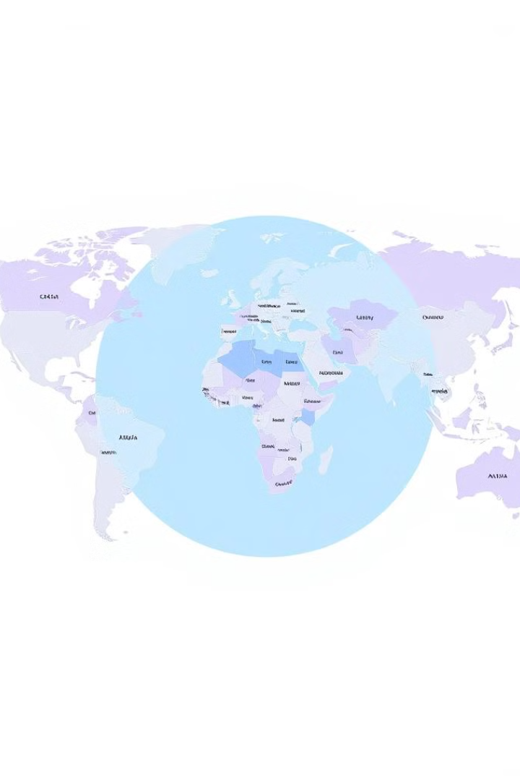
Reaching the Target Audience
Children (10-18 years) are primary users, facing the most significant risks.
Schools, parents, and mental health professionals are key stakeholders in the system.
The market is ripe for AI-driven solutions as demand for mental health support grows.

Slide 4
How MindGuard+ Works
AI-Powered Behavioral Monitoring
Real-Time Risk Detection & Alerts
AI Mental Health Companion
A dedicated chatbot provides emotional support, mindfulness exercises, and counseling for users.
MindGuard+ uses advanced AI to analyze search queries, social media interactions, and digital patterns.
The AI assigns risk scores and alerts parents, schools, and mental health professionals to potential issues.

Slide 5
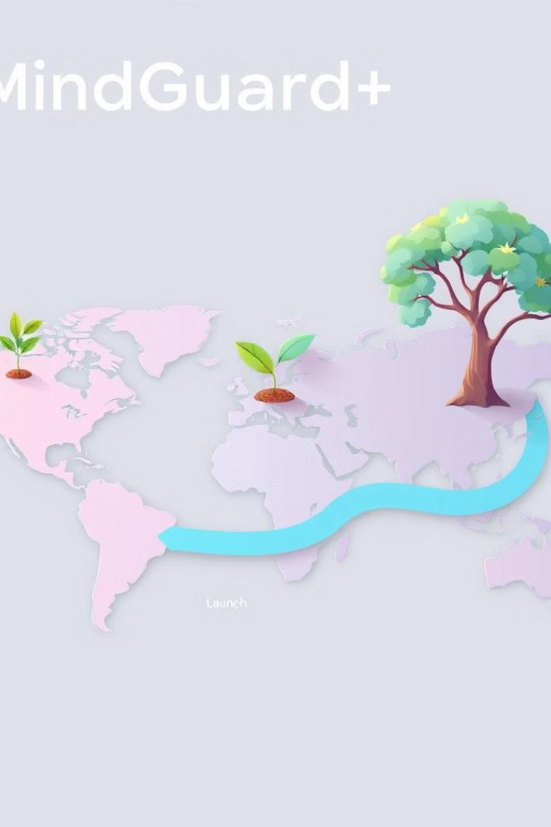
Scaling MindGuard+ for Impact
1
Phase 1: Pilot implementation in schools and healthcare institutions.
2
Phase 2: Expansion to government-backed mental health programs.
3
Phase 3: Global partnerships for AI-driven mental health solutions.

Slide 6
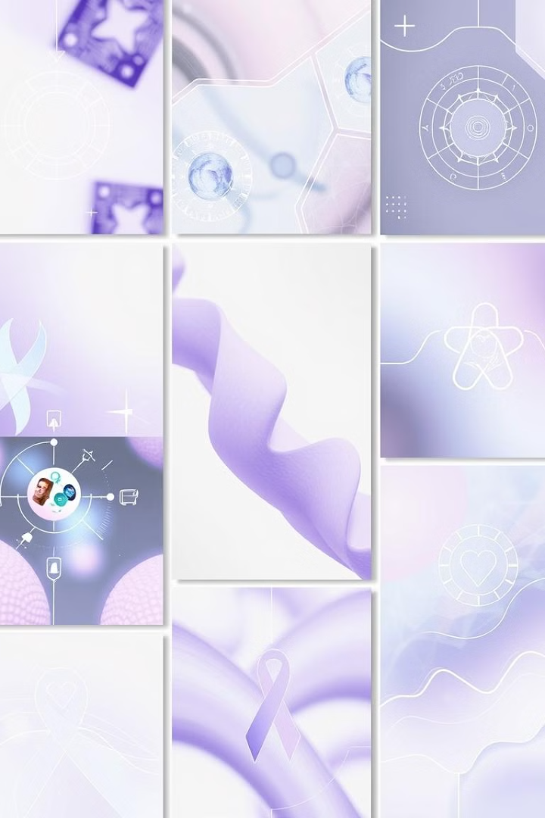



Design Guidelines
Modern, professional layout that reflects the tech + healthcare themes.
Soothing blue, green, and purple colors represent mental wellness and calm.
Icons and visuals depict AI-driven monitoring, mental health awareness, and chatbot interactions.

Slide 7

Join the MindGuard+ Revolution
MindGuard+ is more than just a technology; it's a commitment to protecting the mental well-being of our youth. Join us in revolutionizing digital mental health protection!

